Slide 1
Tesina in Computer Vision Virtual meeting No. 1
Advisor: Matteo Matteucci
Student: Rodrigo Ortiz Cayón

Slide 2
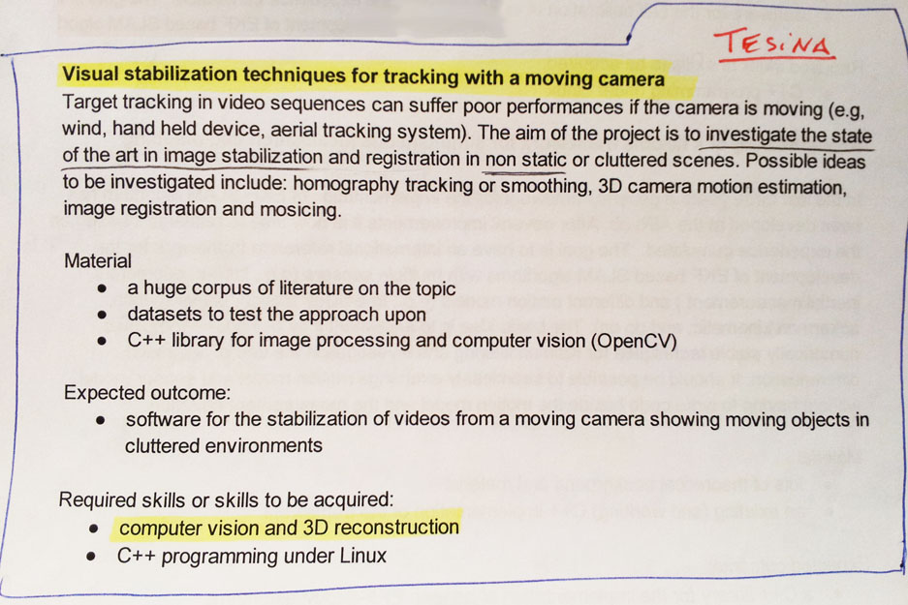
Starting Guides
1
2
Visual stabilization techniques for tracking with a moving camera
Tuning mechanical motion control parameters of UAV based on visual motion measurements
…by measuring…
The amount of correction needed to stabilize the image.
The amount of blur induced on the image due to motion.

Slide 3
Objectives of the meeting
Review about what I have done.
Verify if I’m in the good way.
Define objectives and next steps.
Clarify doubts.

Slide 4
Review about what I have done
Directly related
NOT Directly related
Search on DBs.
Read the state of the art.
Play with Matlab.
Organization
Software and tools.
Learn some LaTeX and GIT
Let’s just speak about the state of the art!

Slide 5
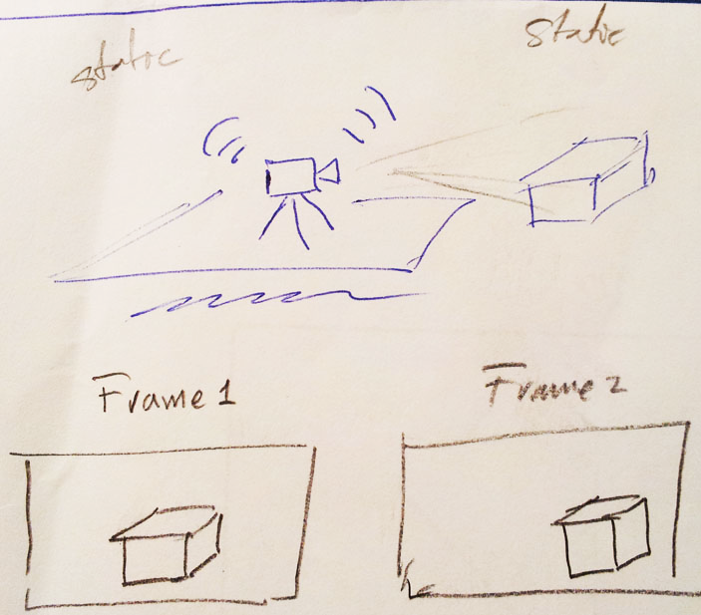
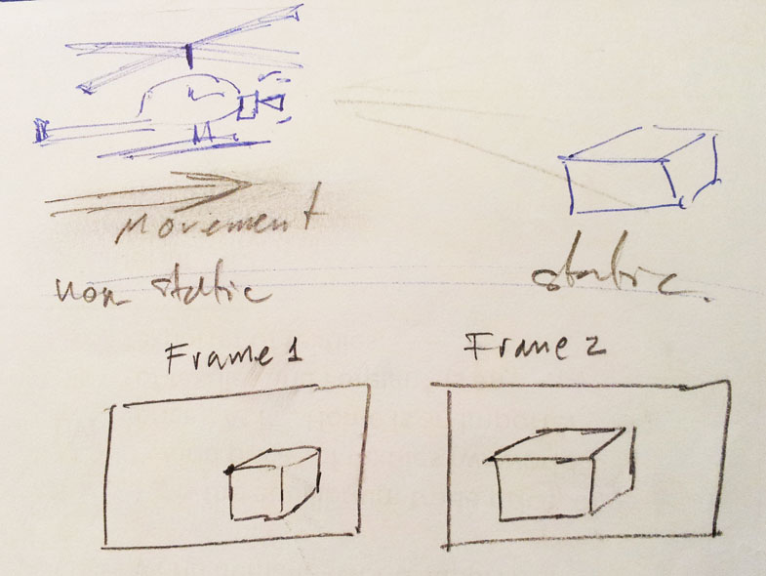
State of the Art Image Stabilization
A bit of Intuition

Slide 6
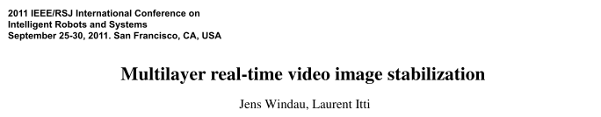
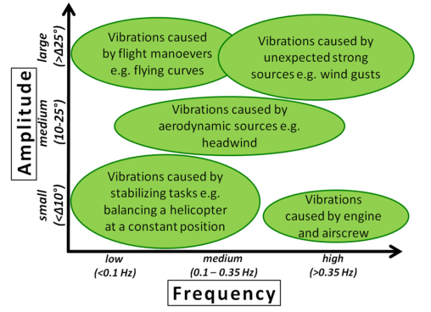
State of the Art Image Stabilization
Sources of vibrations in aerial robotics

Slide 7
State of the Art Image Stabilization
Mechanical Techniques
Electronic Techniques
….
Compute (deviation)
Compensate / adjust control parameters
In Real time!!!

Slide 8
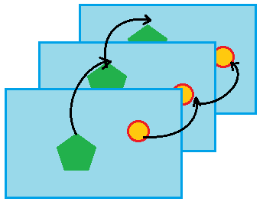
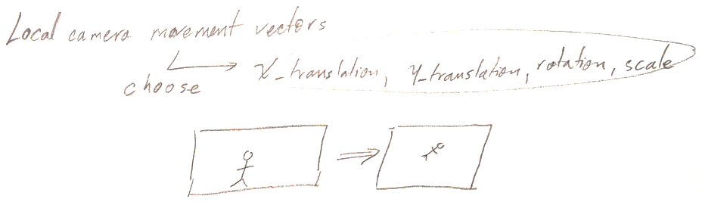
State of the Art Image Stabilization - Steps
1 - Motion Estimation
A set of fast matching strategies.
Matching Algorithm
Optic Flow Estimation
Edge Pattern Matching
Representative Point Matching
Block Matching
Circular Block Matching
Motion Model
Affine
Matching successive frames

Slide 9
State of the Art Image Stabilization - Steps
2 – Global Motion Estimation
With motion parameter.
Which is undesirable motion (vibration)
Restrict Motion to a Model
Low pass filter
9

